Slide 1
Collection Framework
import Java.util.*;

Slide 2
Map: A collection that maps keys to values
Map:
  To represent a group of individual objects as key value pair we use map
  Both Keys and Values are Objects
  The keys must be unique, but the values may be duplicated
  Given a key, you can find its value.
Keys
values
Roll No. | Name
1012 | Dr. Adi Narayan
1013 | Mr. Suresh Kumar
1014 | Mr. Rahul

Slide 3
Maps
Note:
Map is not child interface of Collection.
Maps don’t implement the Iterable interface.
We can obtain a collection-view of a map, which does allow the use of either the for loop or an iterator.

Slide 4
The Map Interfaces
Interface | Description
Map | Maps unique keys to values.
SortedMap | Extends Map so that the keys are maintained in ascending order.
NavigableMap | Extends SortedMap to handle the retrieval of entries based on closest-match searches.
Map.Entry | Describes an element (a key/value pair) in a map. This is an inner class of Map.

Slide 5
Map Interface
The Map interface maps unique keys to values.
A key is an object used to retrieve a value.( at a later date.)
Given a key and a value, you can store the value in a Map object.
Map is generic :
interface Map<K, V>

Slide 6
Map Interface - Methods
Method | Description
V put(Object key, Object value) | It is used to insert an entry in the map.
void putAll(Map map) | It is used to insert the specified map in the map.
V putIfAbsent(K key, V value) | It inserts the specified value with the specified key in the map only if it is not already specified.
V remove(Object key) | It is used to delete an entry for the specified key.
boolean remove(Object key, Object value) | It removes the specified values with the associated specified keys from the map.
Set keySet() | It returns the Set view containing all the keys.
Set<Map.Entry<K,V>> entrySet() | It returns the Set view containing all the keys and values.
void clear() | It is used to reset the map.
boolean equals(Object o) | It is used to compare the specified Object with the Map.

Slide 7
Map Interface - Methods
Method | Description
V get(Object key) | This method returns the object that contains the value associated with the key.
V getOrDefault(Object key, V defaultValue) | It returns the value to which the specified key is mapped, or defaultValue if the map contains no mapping for the key.
int hashCode() | It returns the hash code value for the Map
boolean isEmpty() | This method returns true if the map is empty; returns false if it contains at least one key.
V replace(K key, V value) | It replaces the specified value for a specified key.
boolean replace(K key, V oldValue, V newValue) | It replaces the old value with the new value for a specified key.
Collection values() | It returns a collection view of the values contained in the map.
int size() | This method returns the number of entries in the map.

Slide 8
SortedMap Interface
The SortedMap interface extends Map.
It ensures that the entries are maintained in ascending order based on the keys.
SortedMap is generic :
interface SortedMap<K, V>

Slide 9
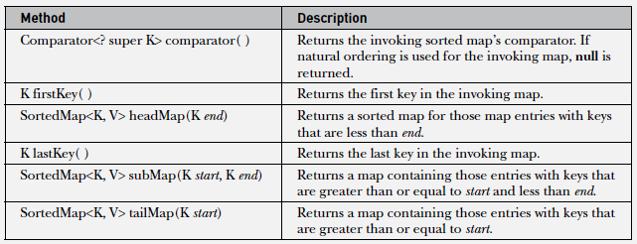
SortedMap Interface - Methods

Slide 10
NavigableMap Interface
The NavigableMap interface extends SortedMap and declares the behavior of a map that supports the retrieval of entries based on the closest match to a given key or keys.
NavigableMap is a generic interface :
interface NavigableMap<K,V>

Slide 11
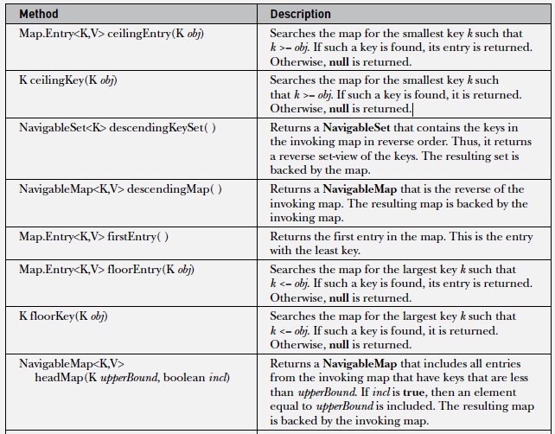
NavigableMap Interface - Methods

Slide 12
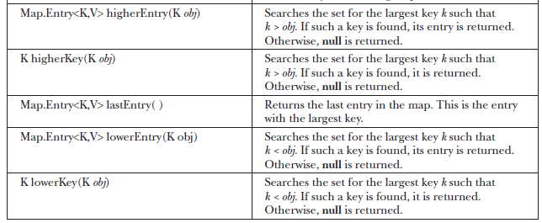
NavigableMap Interface - Methods

Slide 13
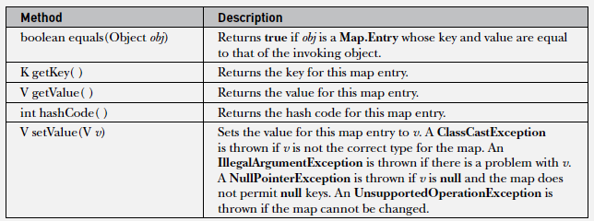
Map.Entry Interface
Each Key-Value pair is called “Entry”.
The Map.Entry interface enables you to work with a map entry.
Interface Entry is defined inside Map interface.

Slide 14
The Map Classes
HashMap Class
TreeMap Class
LinkedHashMap Class
Hash table and linked list implementation of the Map interface, with predictable iteration order.
IdentityHashMap Class
This class implements the Map interface with a hash table, using reference-equality in place of object-equality when comparing keys (and values)
EnumMap Class
  A specialized Map implementation for use with enum type keys

Slide 15
HashMap Class
The HashMap class extends AbstractMap and implements the Map interface.
It uses a hash table to store the map.
Heterogeneous Objects allowed
Insertion order not preserved.
Null keys allowed only once
null values allowed any number of times
HashMap is a generic class :
class HashMap<K, V>
Constructors :
HashMap( ) // default capacity is 16.
HashMap(Map<? extends K, ? extends V> m)
HashMap(int capacity)
  HashMap(int capacity, float fillRatio) // default fill ratio is 0.75

Slide 16
import java.util.*;
class HashMapDemo {
public static void main(String args[]) {
// Create a hash map.
HashMap<String, Double> hm = new HashMap<String, Double>();
// Put elements to the map
hm.put("John Doe", new Double(3434.34));
hm.put("Tom Smith", new Double(123.22));
hm.put("Jane Baker", new Double(1378.00));
hm.put("Tod Hall", new Double(99.22));
hm.put("Ralph Smith", new Double(-19.08));
System.out.print(hm);
// Get a set of the entries.
Set<Map.Entry<String, Double>> set = hm.entrySet();
// Display the set.
for(Map.Entry<String, Double> me : set) {
System.out.print(me.getKey() + ": ");
System.out.println(me.getValue());
}
System.out.println();
// Deposit 1000 into John Doe's account.
double balance = hm.get("John Doe");
hm.put("John Doe", balance + 1000);
System.out.println("John Doe's new balance: " +hm.get("John Doe"));
}
}

Slide 17
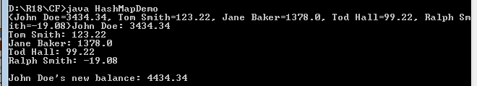

Slide 18
TreeMap Class
The TreeMap class extends AbstractMap and implements the NavigableMap interface.
It creates maps stored in a tree structure. (RED-BLACK tree)
A TreeMap provides an efficient means of storing key/value pairs in sorted order and allows rapid retrieval.
Elements will be sorted in ascending key order.
TreeMap is a generic class :
class TreeMap<K, V>
Constructors :
TreeMap( )
TreeMap(Comparator<? super K> comp)
TreeMap(Map<? extends K, ? extends V> m)
TreeMap(SortedMap<K, ? extends V> sm)

Slide 19
import java.util.*;
class TreeMapDemo {
public static void main(String args[]) {
// Create a tree map.
TreeMap<String, Double> tm = new TreeMap<String, Double>();
// Put elements to the map.
tm.put("John Doe", new Double(3434.34));
tm.put("Tom Smith", new Double(123.22));
tm.put("Jane Baker", new Double(1378.00));
tm.put("Tod Hall", new Double(99.22));
tm.put("Ralph Smith", new Double(-19.08));
System.out.println(tm);
// Get a set of the entries.
Set<Map.Entry<String, Double>> set = tm.entrySet();
// Display the elements.
for(Map.Entry<String, Double> me : set) {
System.out.print(me.getKey() + ": ");
System.out.println(me.getValue());
}
System.out.println();
// Deposit 1000 into John Doe's account.
double balance = tm.get("John Doe");
tm.put("John Doe", balance + 1000);
System.out.println("John Doe's new balance: " + tm.get("John Doe"));
}
}

Slide 20
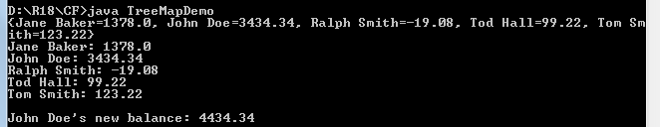

Slide 21
Comparator Interface
Both TreeSet and TreeMap store elements in sorted order using “natural ordering(Ascending order.
If we want to order elements in a different way, then we use a Comparator when we construct the set or map.
Once comparator is defined, the elements are stored within collections and maps according to the sorted order specified in comparator.
Comparator is a generic interface :
interface Comparator<T>

Slide 22
Comparator Interface - Methods
int compare(T obj1, T obj2)
obj1 and obj2 are the objects to be compared. Normally, this method returns zero if the objects are equal. It returns a positive value if obj1 is greater than obj2. Otherwise, a negative value is returned.
boolean equals(object obj)
Tests whether an object equals the invoking comparator. Here, obj is the object to be tested for equality. The method returns true if obj and the invoking object are both Comparator objects and use the same ordering. Otherwise, it returns false.
default Comparator<T> reversed( )
static <T extends Comparable<? super T>> Comparator<T> reverseOrder( )
To obtain a comparator that reverses the ordering of the comparator on which it is Called.

Slide 23
Using a Comparator
The following is an example that demonstrates a custom comparator.
It implements the compare( ) method for strings that operates in reverse of normal. Thus, it causes a tree set to be sorted in reverse order.

Slide 24

// Use a custom comparator.
import java.util.*;
// A reverse comparator for strings.
class MyComp implements Comparator<String> {
public int compare(String aStr, String bStr) {
// Reverse the comparison.
return bStr.compareTo(aStr);
} // No need to override equals or the default methods.
}
class CompDemo {
public static void main(String args[]) {
// Create a tree set.
TreeSet<String> ts = new TreeSet<String>(new MyComp());
// Add elements to the tree set.
ts.add("C");
ts.add("A");
ts.add("B");
ts.add("E");
ts.add("F");
ts.add("D");
// Display the elements.
for(String element : ts)
System.out.print(element + " ");
System.out.println();
} }

Slide 25
To create reverse comparator
class MyComp implements Comparator<String> {
public int compare(String aStr, String bStr) {
return aStr.compareTo(bStr);
}
}
Next, you can use the following sequence to create a TreeSet that orders its string
elements in reverse:
MyComp mc = new MyComp(); // Create a comparator
// Pass a reverse order version of MyComp to TreeSet.
TreeSet<String> ts = new TreeSet<String>(mc.reversed());
// Use a lambda expression to implement Comparator<String>.
Comparator<String> mc = (aStr, bStr) -> aStr.compareTo(bStr);
// Pass a reversed comparator to TreeSet() via a lambda expression.
TreeSet<String> ts = new TreeSet<String>( (aStr, bStr) -> bStr.compareTo(aStr));

Slide 26
Collection Algorithms - Collections class
The Collections Framework defines several algorithms that can be applied to collections`and maps.
These algorithms are defined as static methods within the Collections class.
Algorithms defined by Collections class
checkedCollection( ), which returns what the API documentation refers to as a “dynamically typesafe view” of a collection
synchronizedList( ) and synchronizedSet( ), are used to obtain synchronized (thread-safe) copies of the various collections
int binarySearch(List<? extends T> list, T value, Comparator<? super T> c)
Searches for value in list ordered according to c. Returns the position of value in list, or a negative value if value is not found.

Slide 27
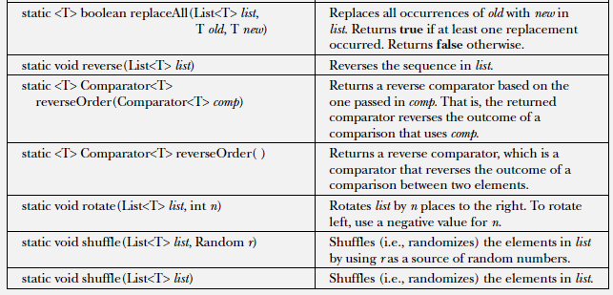
Collection Algorithms - Collections class
Algorithms defined by Collections class

Slide 28

// Demonstrate various algorithms.
import java.util.*;
class AlgorithmsDemo {
public static void main(String args[]) {
// Create and initialize linked list.
LinkedList<Integer> ll = new LinkedList<Integer>();
ll.add(-8);
ll.add(20);
ll.add(-20);
ll.add(8);
// Create a reverse order comparator.
Comparator<Integer> r = Collections.reverseOrder();
// Sort list by using the comparator.
Collections.sort(ll, r);
System.out.print("List sorted in reverse: ");
for(int i : ll)
System.out.print(i+ " ");
System.out.println();
// Shuffle list.
Collections.shuffle(ll);
// Display randomized list.
System.out.print("List shuffled: ");
for(int i : ll)
System.out.print(i + " ");
System.out.println();
System.out.println("Minimum: " + Collections.min(ll));
System.out.println("Maximum: " + Collections.max(ll));
}
}

Slide 29
Arrays class
The Arrays class provides various methods that are useful when working with arrays.
These methods help bridge the gap between collections and arrays.
List asList(T... array) method returns a List that is backed by a specified array
binarySearch( ) method uses a binary search to find a specified value
copyOf( ) method returns a copy of an array
copyOfRange( ) method returns a copy of a range within an array
equals( ) method returns true if two arrays are equivalent. Otherwise, it returns false
fill( ) method assigns a value to all elements in an array
sort( ) method sorts an array so that it is arranged in ascending order

Slide 30
// Demonstrate Arrays class
import java.util.*;
class ArraysDemo
{
public static void main(String args[])
{
// Allocate and initialize array.
int array[] = new int[10];
for(int i = 0; i < 10; i++)
array[i] = -3 * i;
// Display, sort, and display the array.
System.out.print("Original contents: ");
display(array);
Arrays.sort(array);
System.out.print("Sorted: ");
display(array);
// Fill and display the array.
Arrays.fill(array, 2, 6, -1);
System.out.print("After fill(): ");
display(array);

Slide 31

// Sort and display the array.
Arrays.sort(array);
System.out.print("After sorting again: ");
display(array);
// Binary search for -9.
System.out.print("The value -9 is at location ");
int index =
Arrays.binarySearch(array, -9);
System.out.println(index);
}
static void display(int array[]) {
for(int i: array)
System.out.print(i + " ");
System.out.println();
}
}

Slide 32
Collection classes
Vector implements Dynamic Array.
It is similar to ArrayList, but with two difference:
  Vectors are synchronized by default , ArrayLists are not.
  Vector increments 100% means doubles the array size if total number of element exceeds than its capacity, but ArrayList increments 50% of current array size if number of element exceeds from its capacity.
Vector Constructors:
  Vector( ) //creates a default vector with initial size of 10.
  Vector(int size) //creates a vector whose initial capacity is specified by size.
  Vector(int size, int incr) // creates a vector with initial capacity and increment is specified by incr
  Vector(Collection c) //creates a vector that contains the elements of collection c.
Methods defined by Vector

